Slide 1

Hello Volunteers
Welcome to

Slide 2
Here are the session plans for the month of
October

Slide 3
Teams for the sessions

Slide 4
Session number
And Session In Charges
WINGS
PLANE AND PILOTS
Session Number 1
Rukaiya Jahan Ria
Session Number 1
Refat Mahmud Sejan
Israt Jahan Tumpa, Munira Jahan
Ahsan Abeer, Safiqa Hossain
Session Number 2
Jannatus Salam Marjan
Sumaiya Zerin, Amina Ahmed Moona
Armina Khandoker Nayna, Jannatus Salam Marjan
Session Number 3
Rukaiya Jahan Ria
Session Number 3
Sangita Bhattacharjee
Sangita Bhattacharjee, Jarin Tasnim Khan
Refat Mahmud Sejan, Sumaiya Zerin
Session Number 4
Afsana Aziz Nitol
Afsana Aziz Nitol, Sangita Bhattacharjee
Israt Nayeema, Mazharul Islam

Slide 5
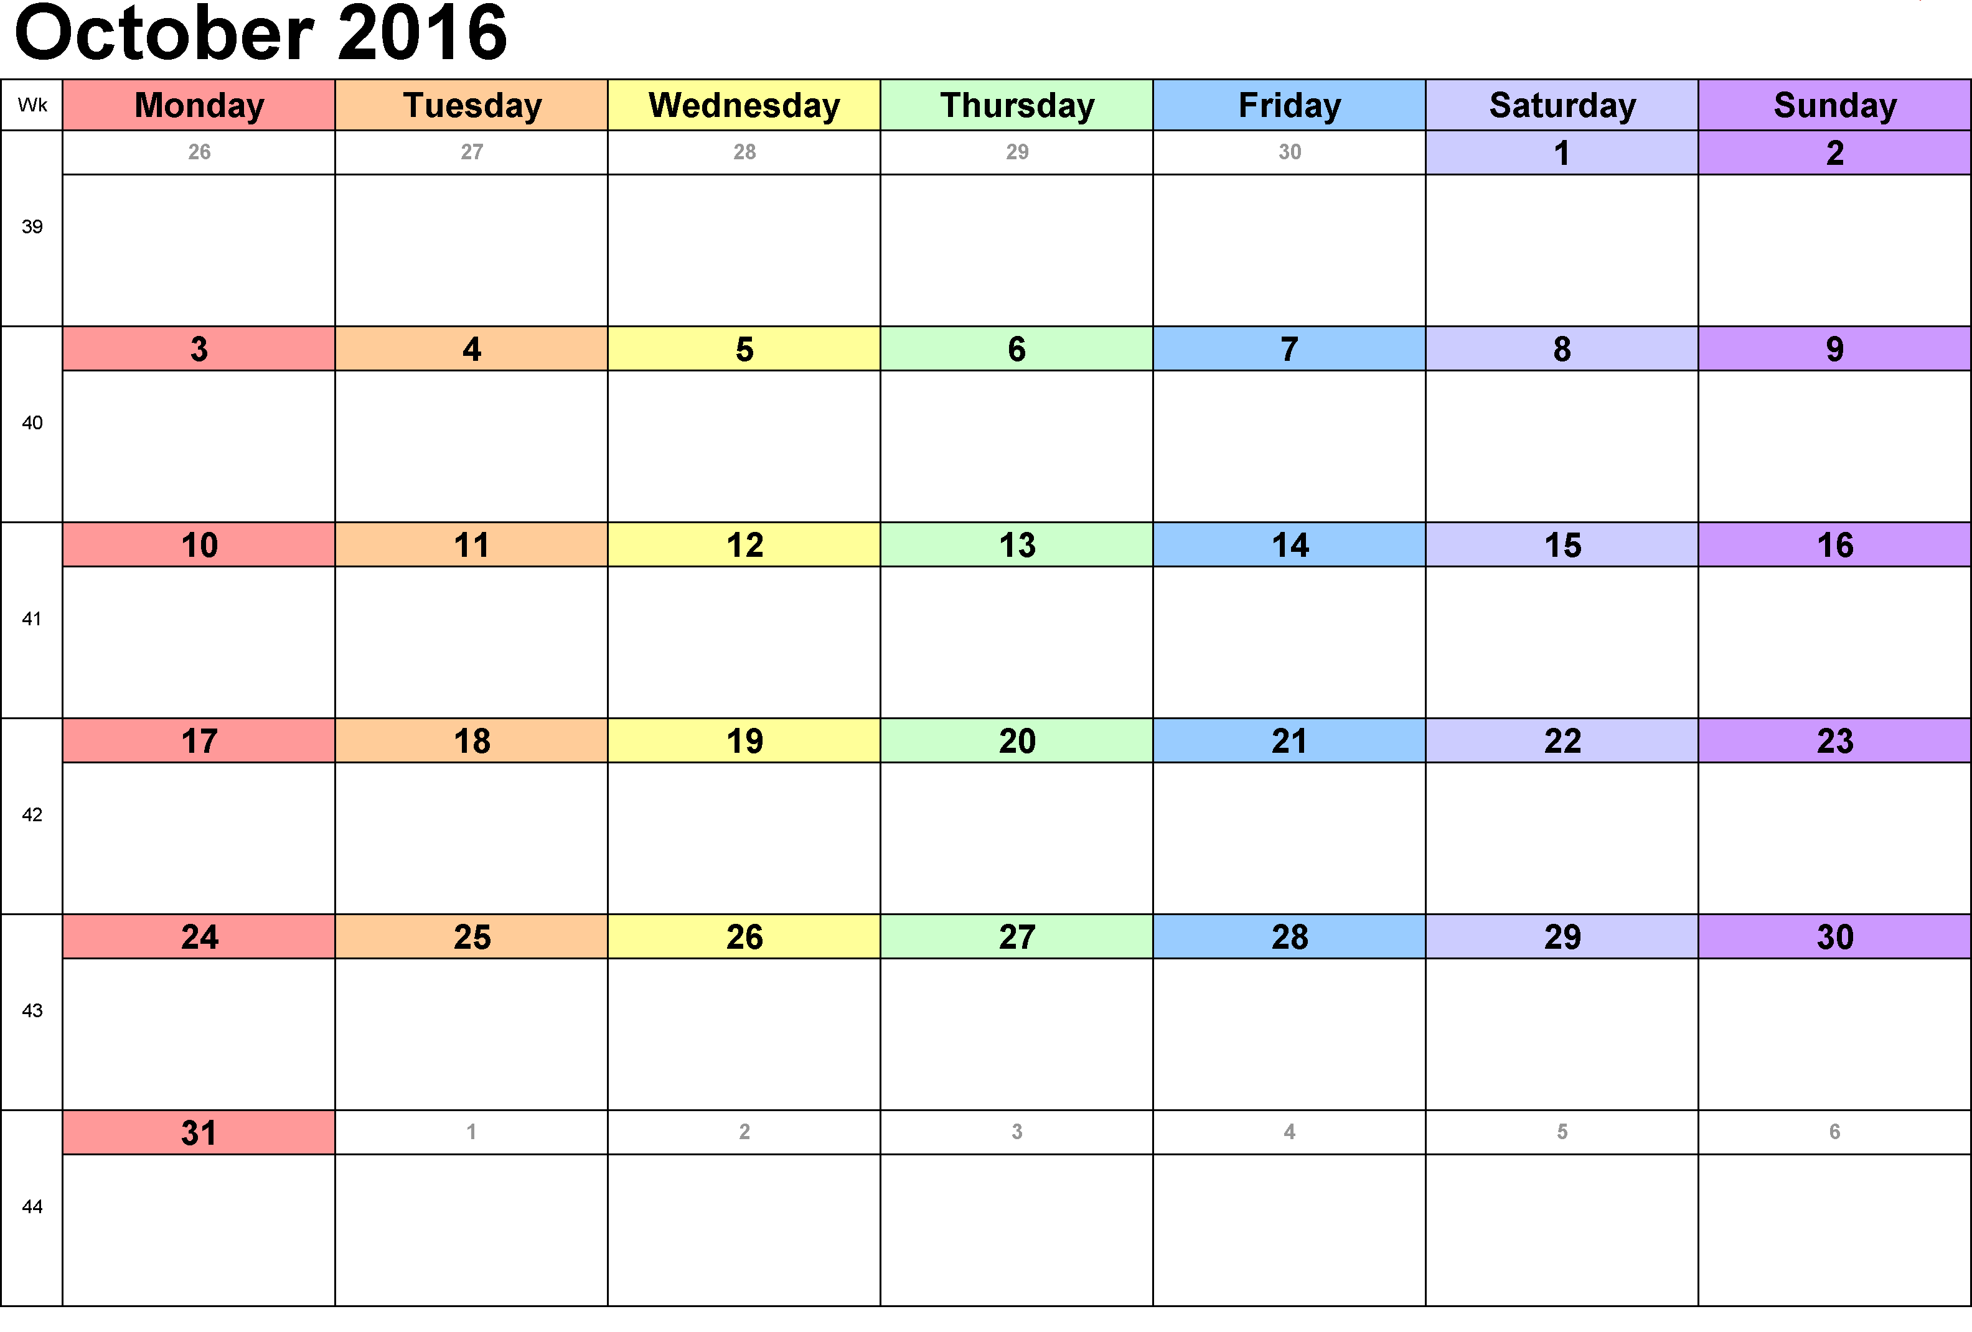
Session 1
Session 2
Session 3
Session 4

Slide 6
WINGS
Dates | Topic | Crafts
19-10-2016 | Counting from (20-40) and review counting (1-10)+Motivational story(by volunteers) | TBD
22-10-2016 | Using the map of Bangladesh to show the Division, Districts, etc + show a video of sisimpur | TBD
24-10-2016 | Teach them to spell their name in bangla and English + show sisimpur video + draw pictures and make them sign their name | TBD
30-10-2016 | Sundarbans(just show them pictures or videos and let them know about the animals,plants of it) | TBD

Slide 7
Planes & Pilots
Dates | Topic | Crafts
19-10-2016 | Historical places of Bangladesh(Except Dhaka or make a short review about Dhaka because a previous session happened on Dhaka): Name of the places, show Images, explain the history + video clip of the historical places in Bangladesh+any one inspirational story | TBD
22-10-2016 | Book reading session 01-Pick an English story and make each children read a paragraph and help them in pronunciations and make it interesting by explaining the story in Bangla so that they can learn some English words with meaning | TBD
24-10-2016 | Plant Phototropism + video + start a project of plant phototropism | TBD
30-10-2016 | The big mangrove forest:Sundarbans(what does mangrove forest means? show pictures,videos and importance of it)+any motivational story | TBD

Slide 8


